Slide 1
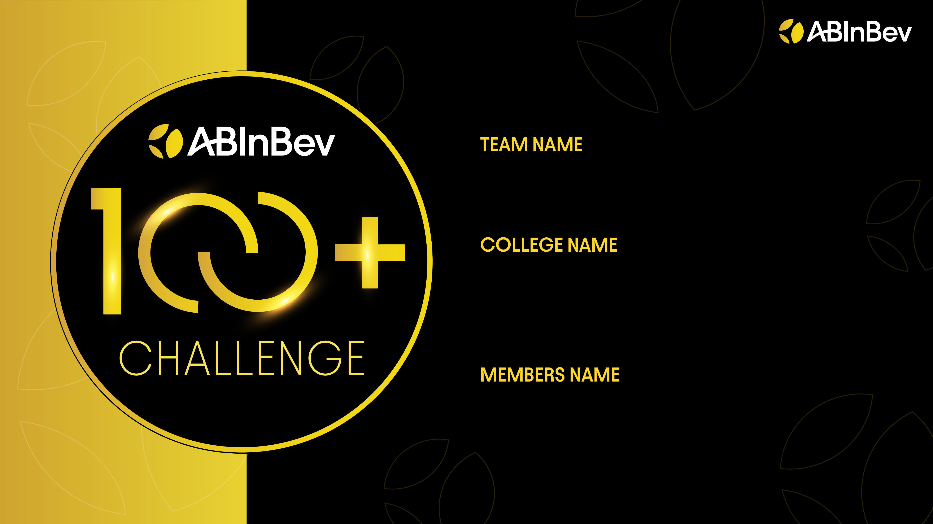
706630-U18X23AG
XLRI Jamshedpur
Debosree Roy
Drisha Paul Aabhaas Dasgupta

Slide 2
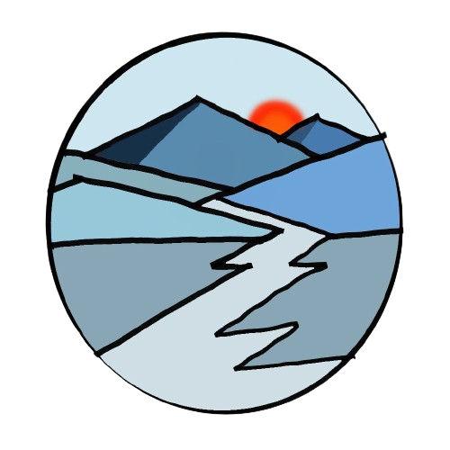
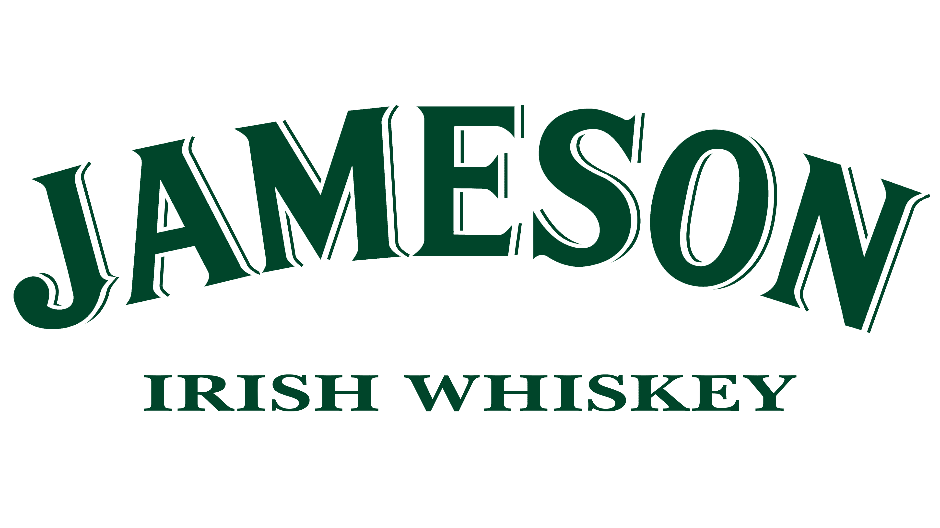
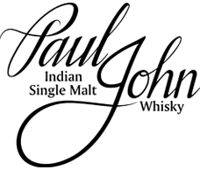
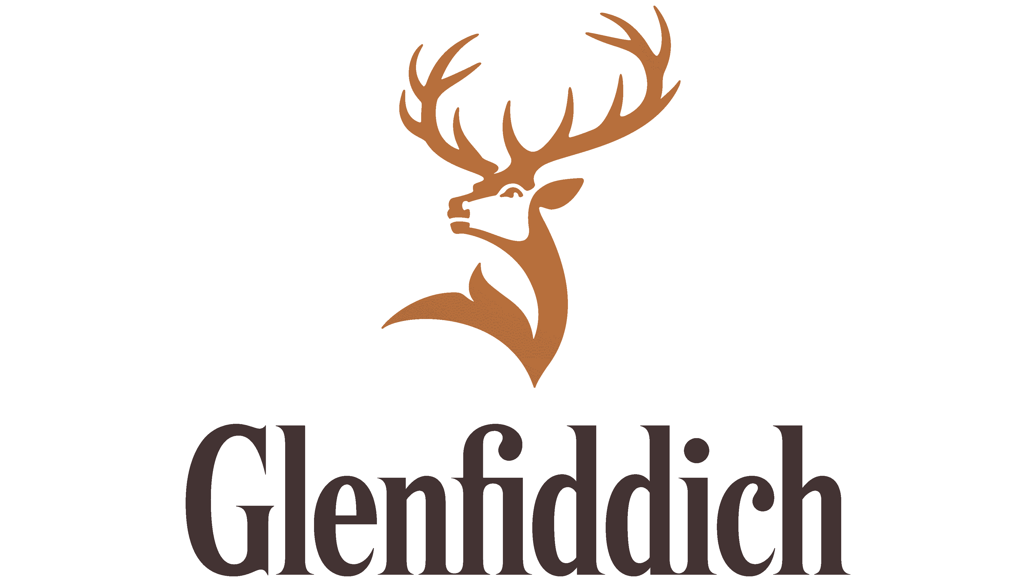


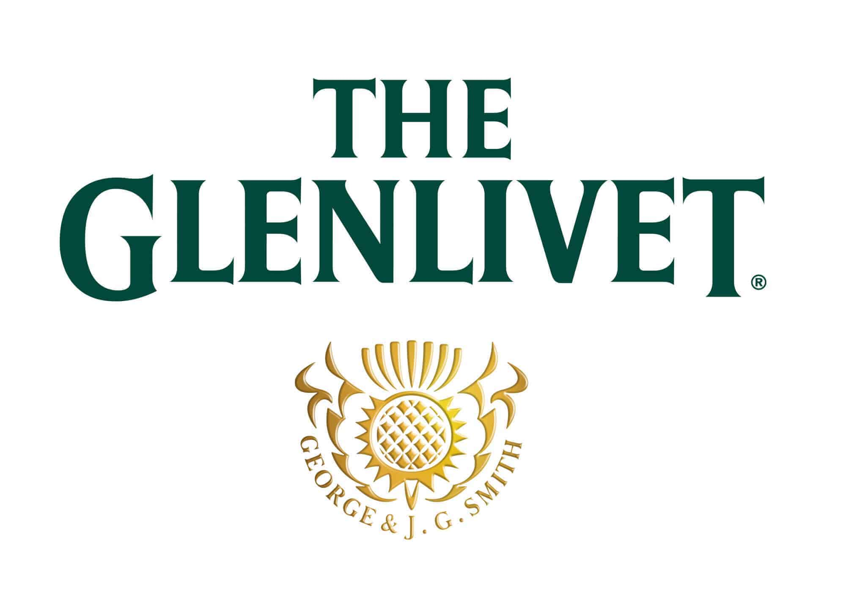
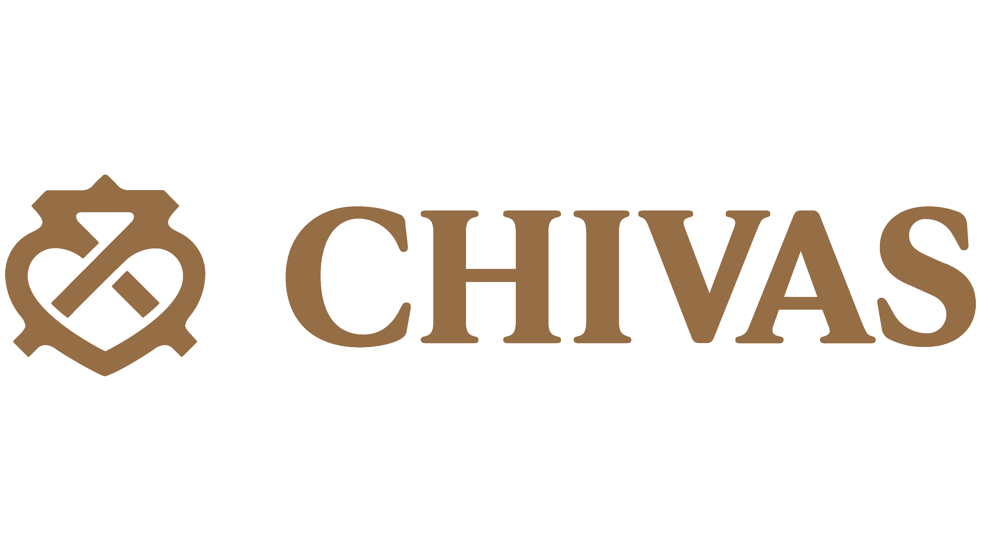
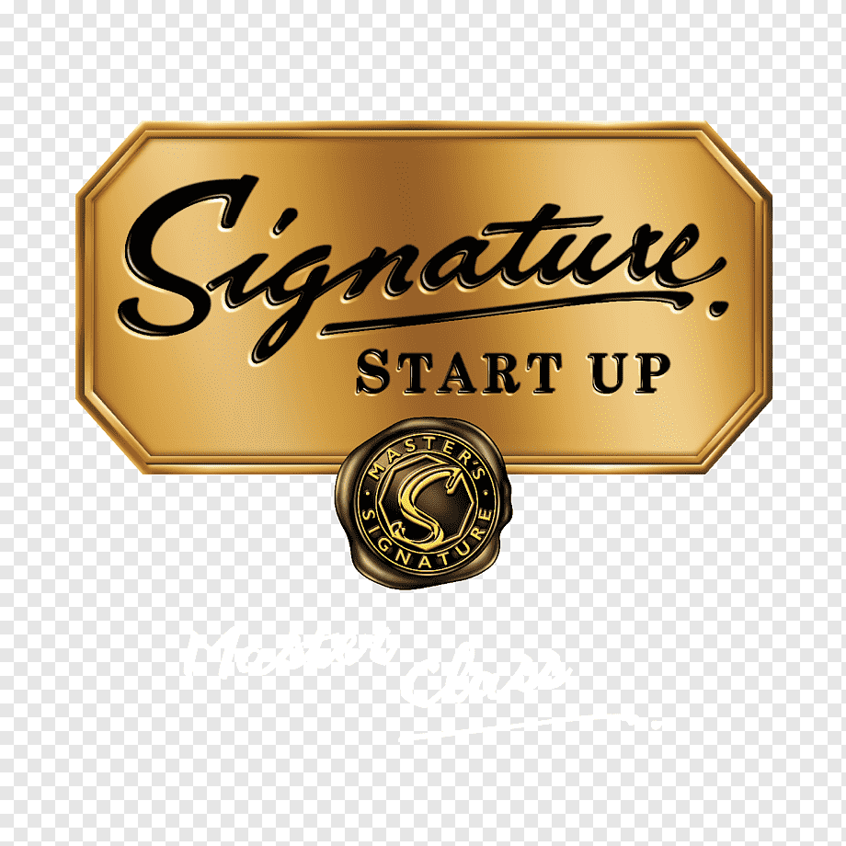
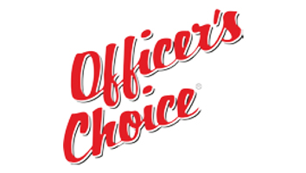
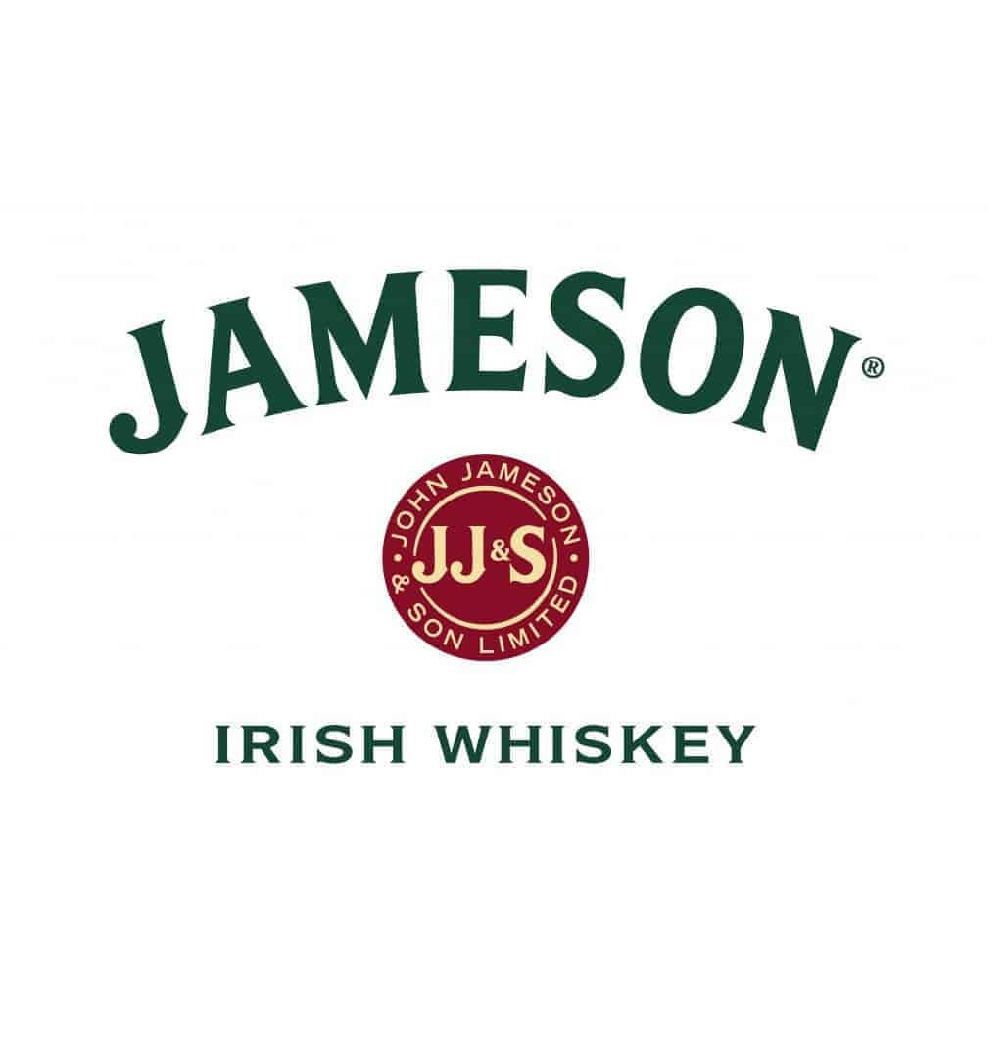
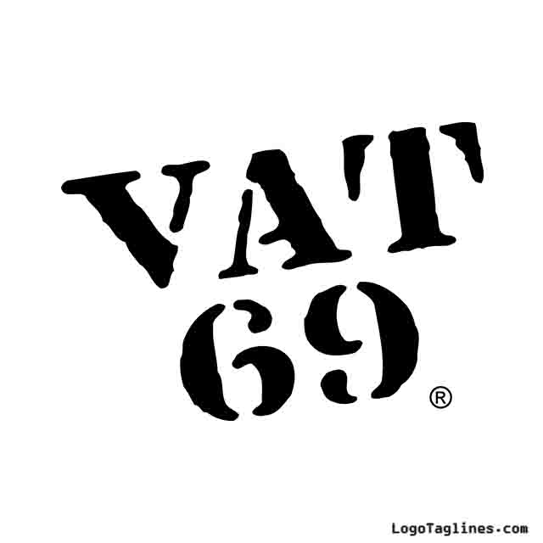
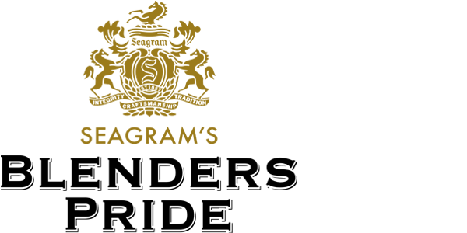
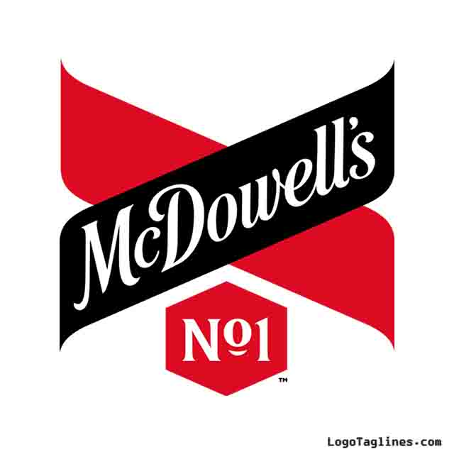
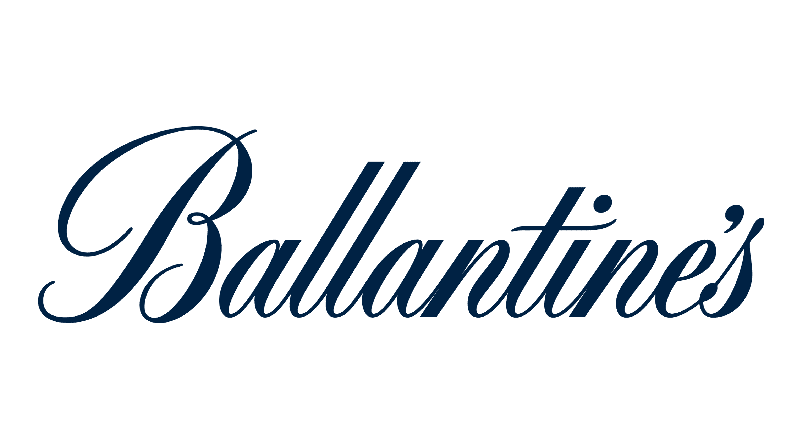
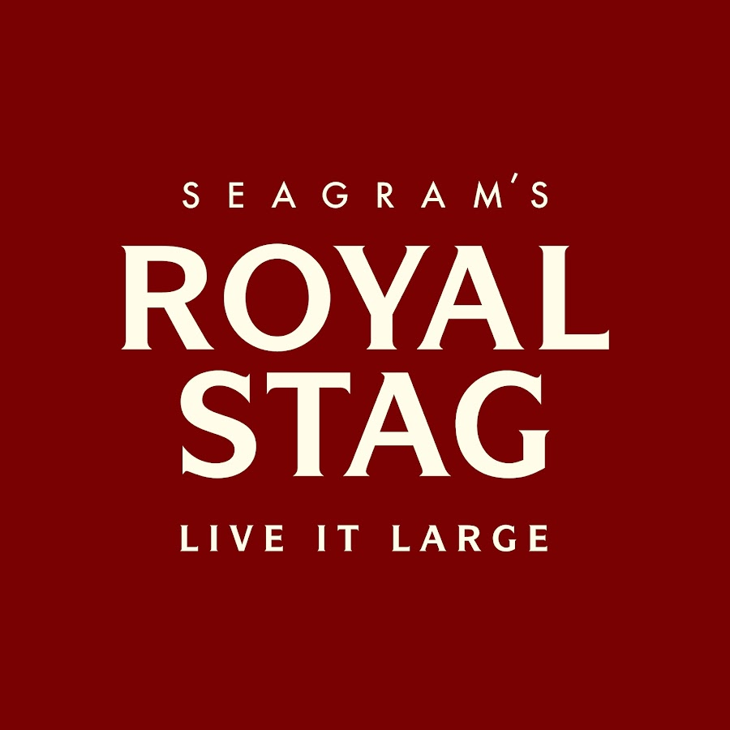
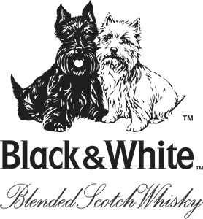
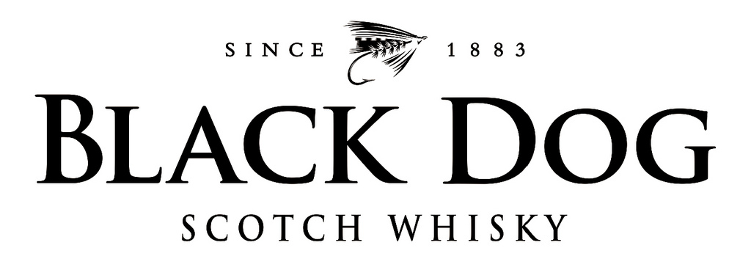
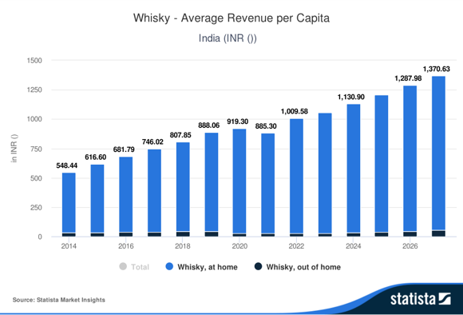
Industry
ABI In NE
Our consumers
Presenting MODIVA
ESG analysis
Where we play?
Financials
What next?
Whisky is a growing market in India, and is currently untapped market by ABI, making an exciting proposition…
The Market Existing Players
Premium
Blue ocean strategy- we play here, premium and Indigenous segment
High
(3)
4.8-28 L Upper mid
( 23%)
<2.4L(45%)
2.4-4.8L(Lower mid) (29%)
Luxury and premium segment
Rapidly growing market, with 45 % falling in this category by 2030
Growing market with the increasing rich
Growing market, where ABI foray into
Indian
Foreign
What is the next big thing?.........
The whiskey segment was the market's most lucrative in 2021, with total revenues of $23.7b, equivalent to 61.6%of the market's overall value.
Where We Play?
Value
Untapped market
Consumer preference
Whiskey revenue in India
Current Associations
People associate ABI as a brand for the young only, whiskey is age agnostic. Opportunity to cut through ages
Whiskey is associated with celebration, gathering, achievement, smooth taste
Rise in preference for Indigenously made spirits
community

Slide 3
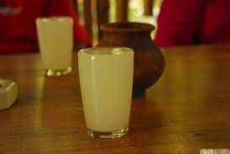
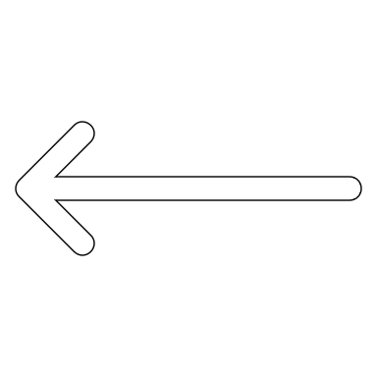
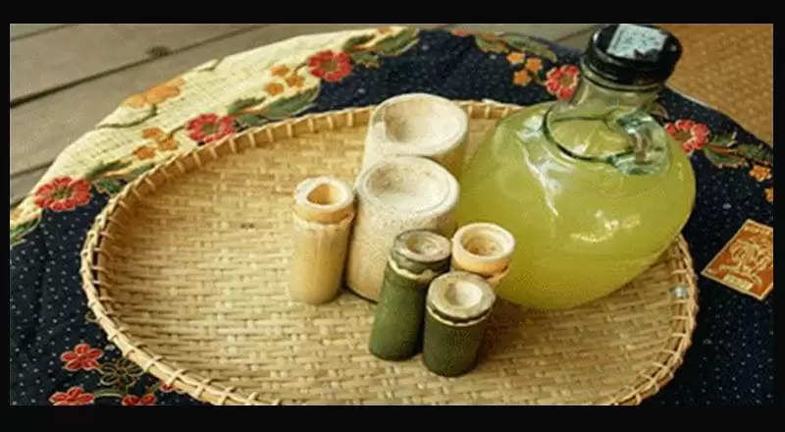
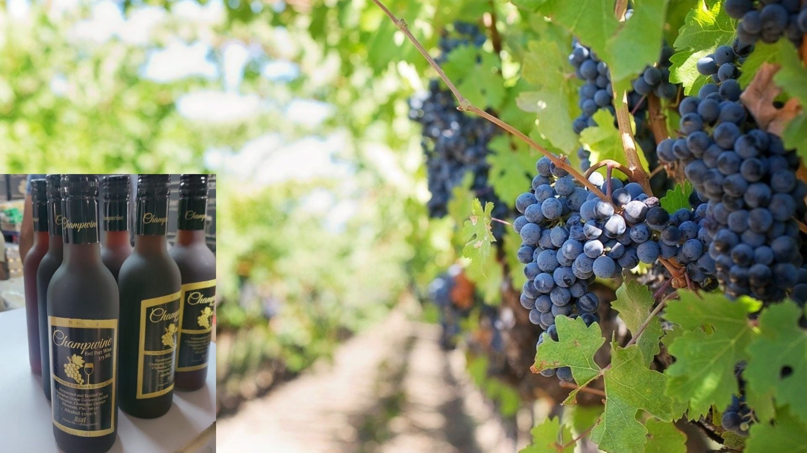
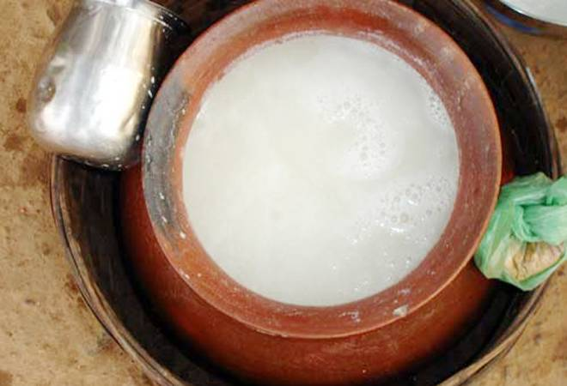
Industry
ABI In NE
Our consumers
Presenting MODIVA
ESG analysis
Where we play?
Financials
What next?
NE provides perfect synergy & landscape to launch ABInBev in premium whisky market, all while giving back
ABInBev Values
Why North-East and East?
Serves as an engine for economic growth, sustainable growth
The organisation thrives when communities thrive
Never takes shortcuts
Leader for change and innovate for customers
The organisation dreams big
Synergy Analysis between ABinBev and Rice Whisky
High Impact
Value Creation
Sulai, Assam
Moderate Impact
Cost
Capital
Revenue
Operational Synergy:
Achieving Economies of Scope
High initial customer acquisition cost.
Low capex investment due to existing Budweiser magnum
New untapped market. Increase in revenue
Sustainable income source to farmers- steady stream of income. Farmers struggle in in N-E India due to the timeless prevalence of shifting cultivation.​
Kiad, Meghalaya
Financially empower the last remaining matriarchal tribes by empowering them
Learning and innovation:
Aligning to core values and learning from traditional methods
ABI already spends massively on R&D systems Align to their thriving with community principle
Moderate capital investment as systems and processes in place
Can use indigenous techniques further to reduce cost of prod
Champwine,
Mizoram
Preserving the long-lost culture and intricate craftsmanship of traditional beverages and innovate to crafting distinctive
Learning from our tradition and roots- the art of brewing with fruits, herbs, and spices
The plains of Bengal produce highest volume or rice in India
The potential of NE is untapped
An opportunity to give back to the NE
Expand the existing Budweiser magnum brand
Diversify into non-premium malt whiskey
Diversify to premium indigenous rice-whiskey
Mahua, Chattisgarh and Jharkhand

Slide 4

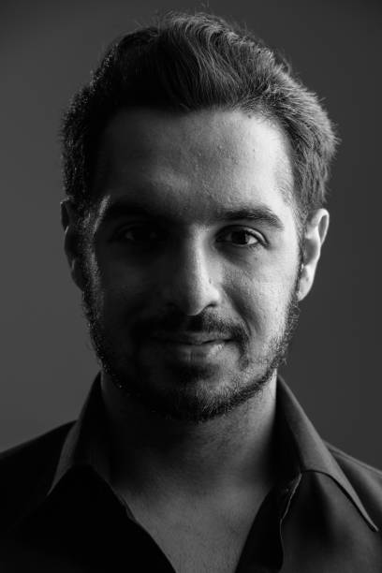

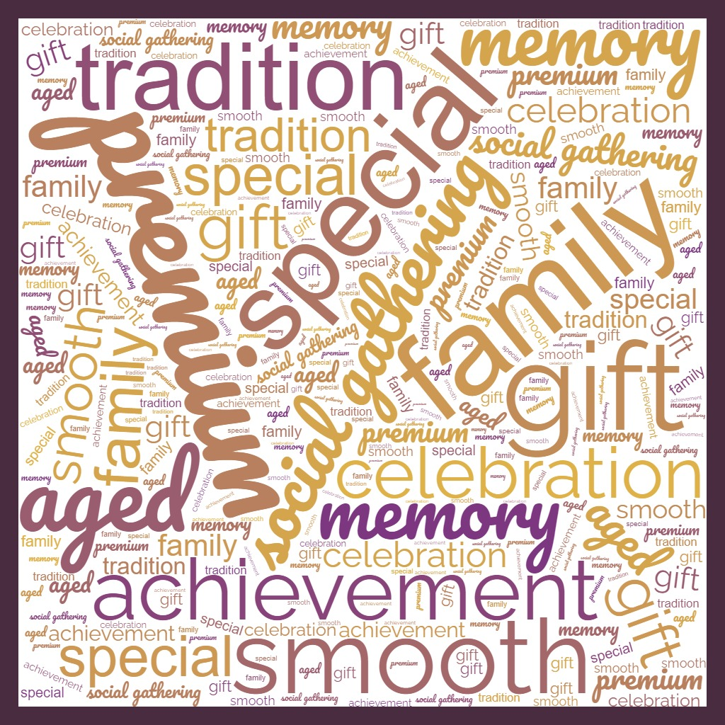
Industry
ABI In NE
Our consumers
Presenting MODIVA
ESG analysis
Where we play?
Financials
What next?
Our consumers are independent, ambitious and value family bonding – across touchpoints…
Consumer personas
Primary Research Insights
(Sample Size-128)
VIJAY, 58
Kolkata
Retired as a senior consultant
Responsible and progressive father who values quality time with his family. Seeks to break the traditional taboo around alcohol consumption.
Values: Family, togetherness, responsible enjoyment
GAURAV, 29
Hyderabad
Started working in a leading tech company
He is young, career-focused individual who's just entered the workforce and wants to celebrate his newfound financial independence and success.
Values: Achievement, socializing, self-expression
GAYATRI, 36
Hyderabad
ed-tech startup founder and active NGO member
she is socially active woman who enjoys alcoholic beverages at gatherings, parties, and social events, loves all things local. Prefers smooth taste
Values: Socializing, sophistication, taste
What comes to your mind when you hear whiskey?
What flavours would you like in your whiskey, if given an option?
Consumer Journey Map
PROCESS​ | AWARENESS​ | CONSIDERATION​ | TRIAL​ | RE-PURCHASE​
TOUCHPOINTS​ | Marketing campaigns​ Word of mouth​ Social media​ Bars and Restaurants visits​ Online reviews​ | Visiting brand websites​ Doing comparison shopping online and offline​ Recommendation​ Taste testing​ | Receive as gifts​ Order premium whiskey at a bar or restaurant​ Request samples at stores or events​ Try during travel​ | Receive promotions and marketing content on mail​ Rewards and loyalty programs​ Referral discounts​
CUSTOMER PROCESS​ | Learn about the category and different brands​ Develop an interest​ Identify needs​ | Research different brands​ Compare the USPs and availability​ Ask friends for recommendations​ ​ | Try the whiskeys​ Evaluate the product and service experience​ Make a purchase decision​ | Repurchase the same brand ​ Develop loyalty Read more on it and refer friends​

Slide 5
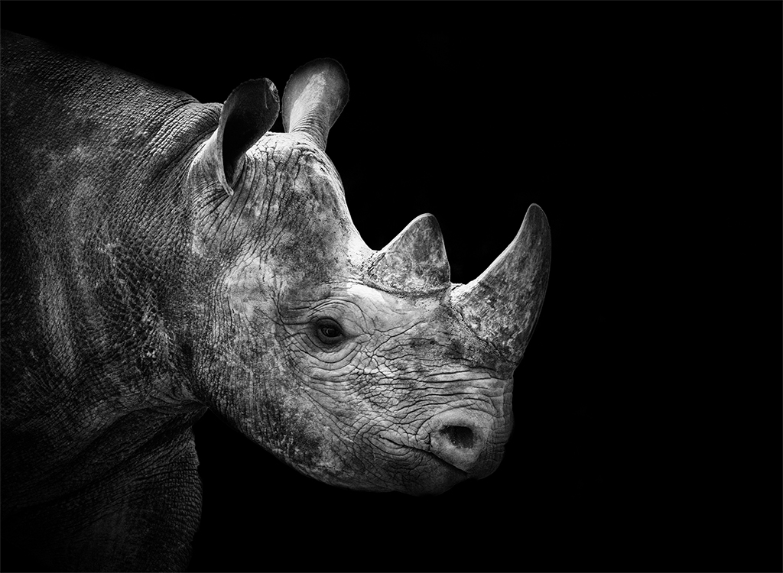
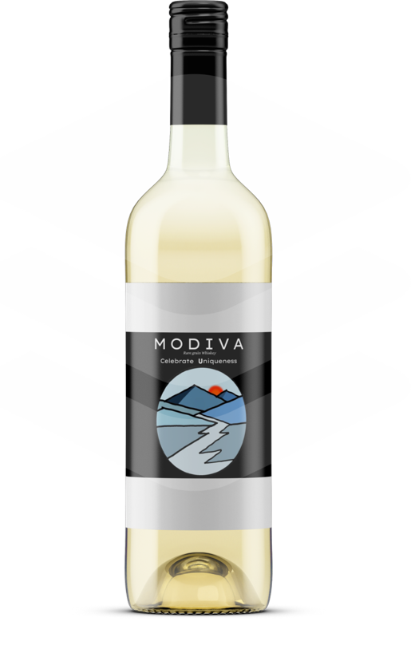
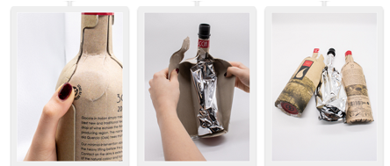
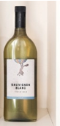
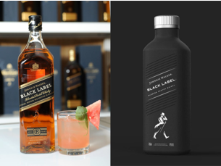
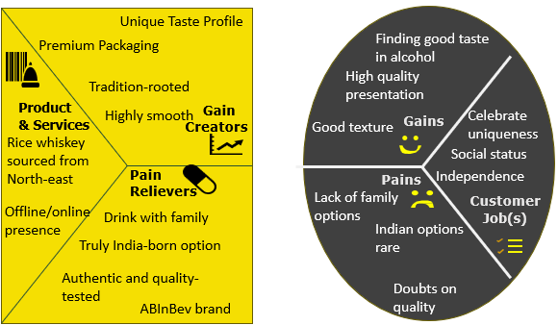
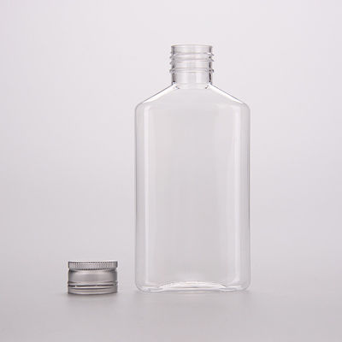
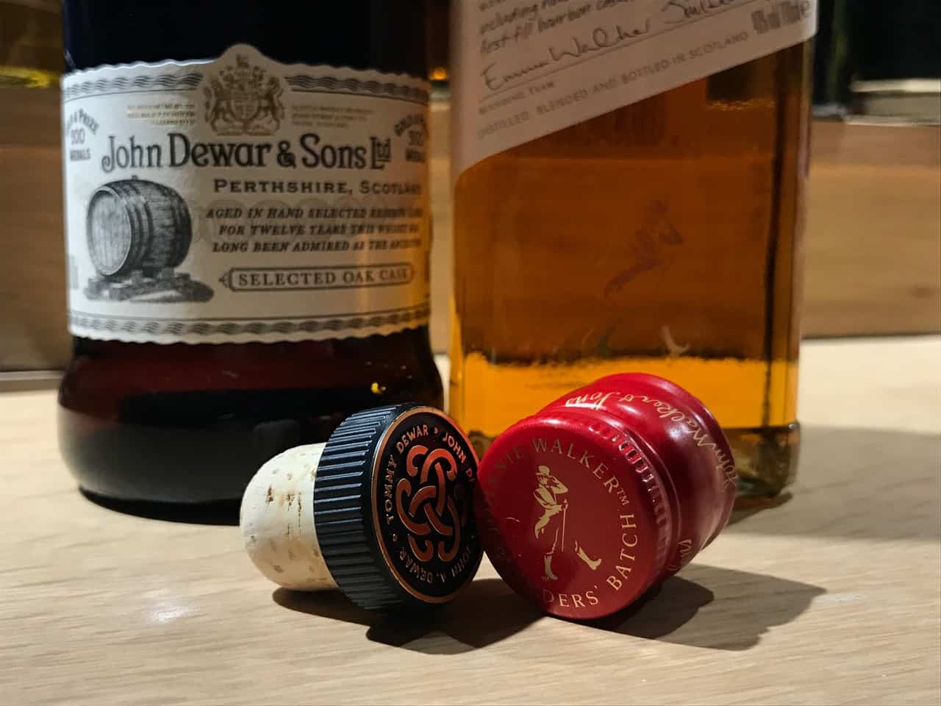
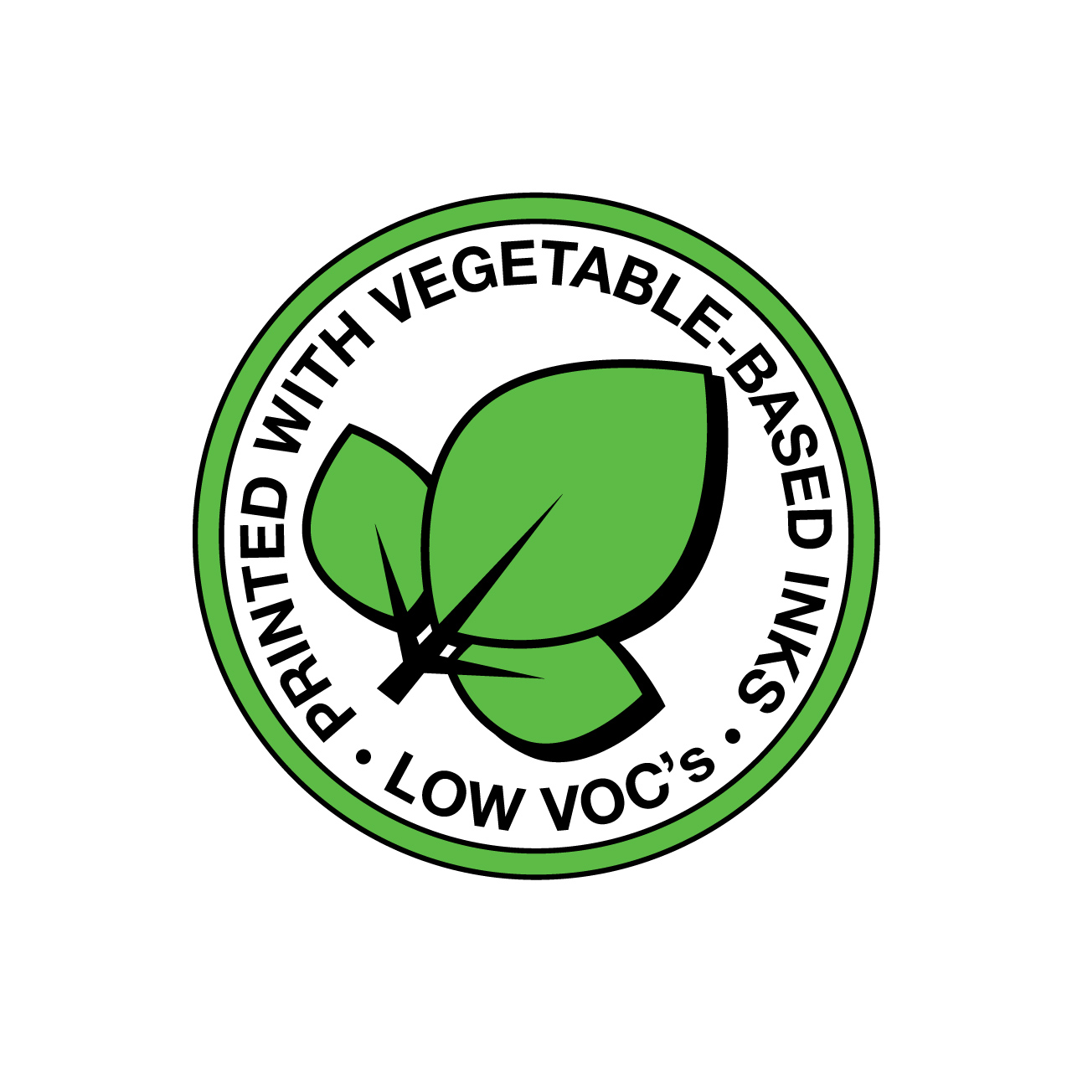
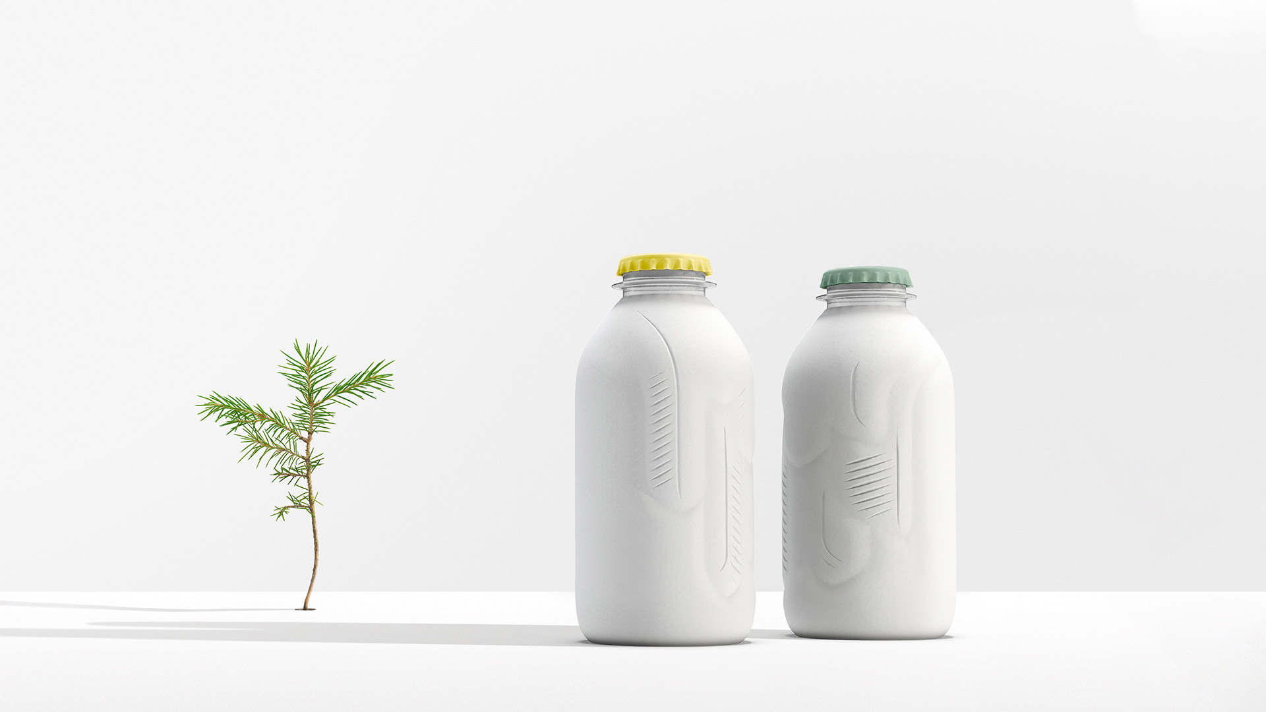
Industry
ABI In NE
Our consumers
Presenting MODIVA
ESG analysis
Where we play?
Financials
What next?
MODIVA – a premium rice whiskey rooted in tradition and uniqueness– Straight out of North-East…
Tradition. BOTTLED.
Brand Persona
The Rhinoceros
Presenting MODIVA
Celebrating UNIQUEness
Logo depicting the nature of North-East India
The Great One:
Ancient Occupation: Guardian of the rice
Symbolizes Peace, tranquility, and protecting the land. He is rare and precious. He isn’t pompous but makes his presence felt
Personality
The Great One is a wise and gentle giant. He is strong and powerful, a guardian of the North-East, royal and regal. It is powerful, majestic and rare
MODIVA-inspired from Assamese MOD
Cellulose-fiber packaging (Signal 7)​
Rice from the north-east, later from plains of Bengal and Jharkhand
Introduced in cinnamon apple and cherry flavour
Brand value proposition
Paper packaging(Black label)​
Logo depicting the hills and rivers of North-East
BPA free pet bottle (Hardy’s)​
Proposed packaging
Regal black representing brand synergy
Comes in local artisan crafted wooden box
Screw-cap closure
PET bottles
For every bottle sold, a fixed amount goes back to the NE
Recycled paper bottle
Vegetable ink

Slide 6








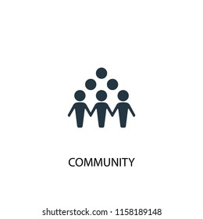




Industry
ABI In NE
Our consumers
Presenting MODIVA
ESG analysis
Where we play?
Financials
What next?
MODIVA gives back to the planet, transforming lives of farmers and tribals – creating better communities…
Supply chain and ESG
MODIVA- A local brand
Impacting lives, making a change
Inclusive
Across all ages. Memories that transcend generations. Value creation for all stakeholders
Farmer-centric approach for sustainable agriculture. Improving water accessibility and security through local watersheds
Financial, digital, and social inclusion to SMEs and MSMEs from farmers who grow our crops supporting local smallholder farmers
Natural
The best ingredients sourced from the North-east, learning the best indigenous techniques from the farmers and scaling it for production
.
Shareholder Value chain analysis
In the existing manufacturing facility. Flavours added in the last stage
Brewers
To tier 1, mega and metro cities
Local
From the north-east valleys and plains of West Bengal
From the north-east valleys and plains of West Bengal
Impacting the lives of …..farmers Collaborating with…...communities
Endeavouring to give back to the North-East
Farmers
Distributors
MODIVA Is our way of way of giving back to local communities. The journey begins here…….
Communities
Consumers
Customers
To where it all began. The people, the tribal communities, improving farming methods
Promising an experiential journey. Making them connect to our rich heritage
Premium bars, boutique hotels, resorts, gifting outlets. Will gradually penetrate B2C as well

Slide 7
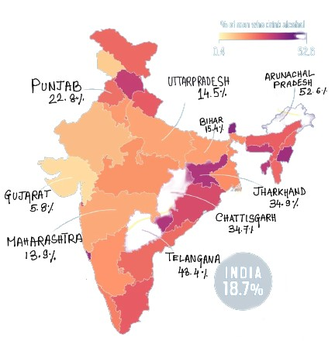
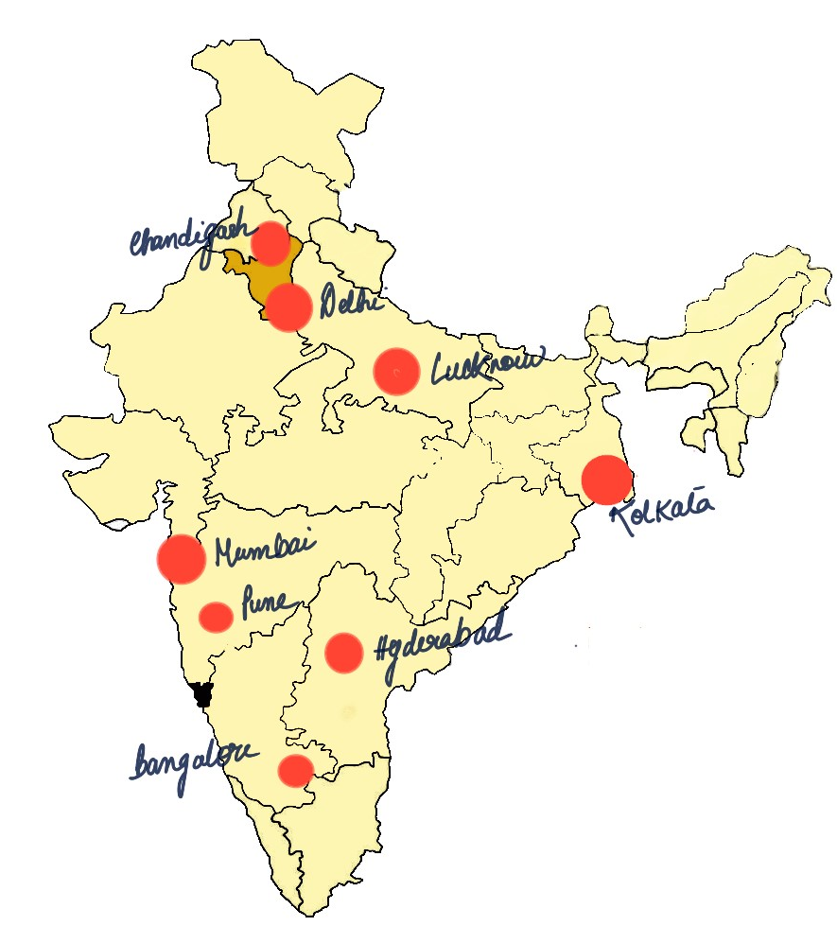

Industry
ABI In NE
Our consumers
Presenting MODIVA
ESG analysis
Where we play?
Financials
What next?
We start in the metros and expand to strategic states – all fuelled by 360-degree marketing around NE Tourism….
Current market/distribution
Where we play?
Marketing Strategy
E-COMMERCE
Partner with upscale bars, restaurants, and clubs.
Partner with bars for premium whiskey flights. .
masterclasses & tastings
at partner venues
Partnering with platforms like liquorshop.in and The Whiskey Barrel to reach a wider audience. Limited-time offers
& exclusive online
releases
ON TRADE
Offer personalization
Subscription for regular deliveries
Premium membership with exclusive perks
High retail margin to target high-end retailers for Nature’s Basket and Foodhall for increased visibility and higher perceived value
D2C
HIGH-END RETAIL
AD mock-up
Brand Ambassador
We target the top mega, metro cities for market penetration
then progress to states with highest % consumption
NE has high alcohol consumption, high long-term potential, lack of major players. BLUE ocean strategy
A father shares a glass of premium rice whiskey with his son for the first time.
They savour the rich heritage and it a medium for intergenerational bonding, dispelling taboos and forging enduring memories
North-East Tourism!!
NE boasts diverse culture, stunning landscapes, and rich traditions. Partnering with North-East India Tourism promotes the economy of the states and is authentic

Slide 8
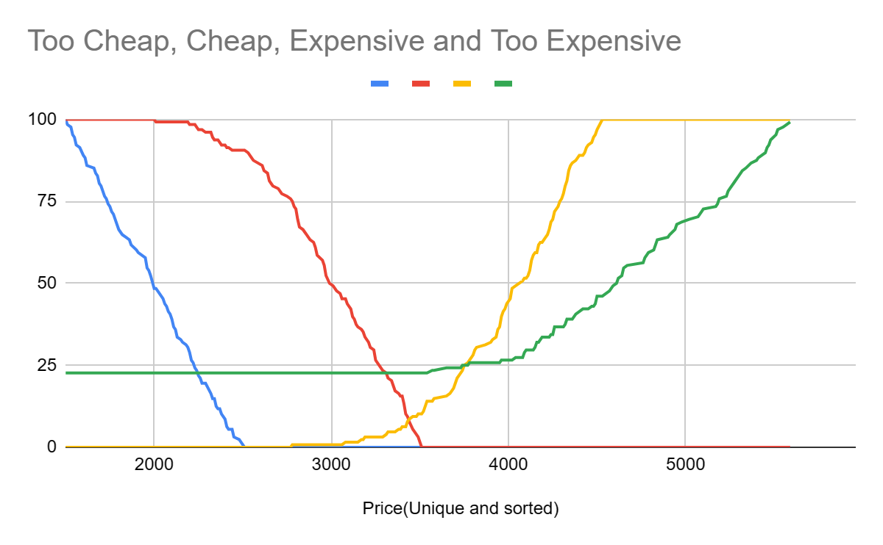
Industry
ABI In NE
Our consumers
Presenting MODIVA
ESG analysis
Where we play?
Financials
What next?
Pricing is deliberately kept premium(INR 4524/SKU), with expected break-even in 3-6 years….
Pricing Financial Viability and Breakeven Analysis
According to Van Westendorp model
Ideal pricing should be INR 3480. The range of price should be INR 3340 to INR 3780
Calculations for avg Premium whiskey(existing) - based on Q1 FY24
Data and assumptions
Market Growth Rate(Whiskey) | 9%
Inflation Rate | 6.70%
% Var cost of Rev | 54.13%
'Value-Based Pricing’ compare to the price of premium whiskeys(e.g. Johnny Walker) in Mumbai/Bangalore, which sells at INR 5000, and price our product slightly less
Ideal price from Van Westendorp model(INR) |  | 3480
Markup added(since selling only in tier 1 metros) |  | 30%
Ideal selling price(INR) |  | 4524
Detailed financials and assumption

Slide 9
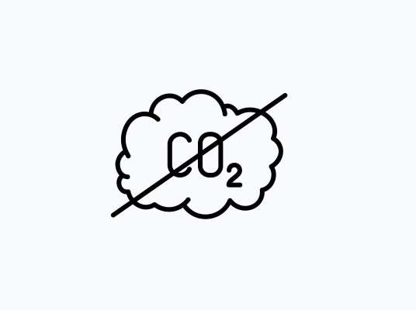
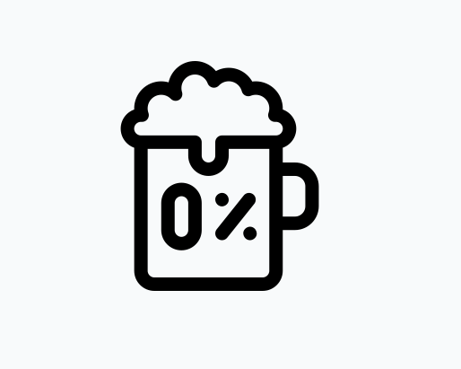


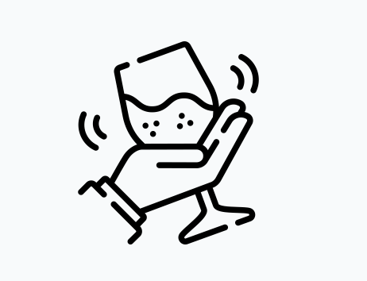
Industry
ABI In NE
Our consumers
Presenting MODIVA
ESG analysis
Where we play?
Financials
What next?
MODIVA presents an exciting future for ABInBev’s brand expansion in India- fuelled by sustainable growth…
Way forward A Roadmap of Sustainable Growth
Which flavour would you like in your alcoholic beverage ?
5
4
Meet the Net Zero Targets for ABInBev
Create a non-alcoholic brand in partnership with athletes like Mary Kom
2
Expanding our sourcing from NE to West Bengal, Odisha and Jharkhand and furthrer
3
Different SKUs(180 ml, 375ml) to try and reach more audiences
1
Challenges ahead
New state-specific flavours like Kokum, Coffee, Mango, Tea
The launch of online sale and home delivery of liquor in certain states shall lead toto market for consume
How to make the product more accessible. The decision as to whether keep it exclusively premium or make it more available
With increasing demand, sourcing of all indigenous ingredients would become difficult
The journey continues…

